Slide 1


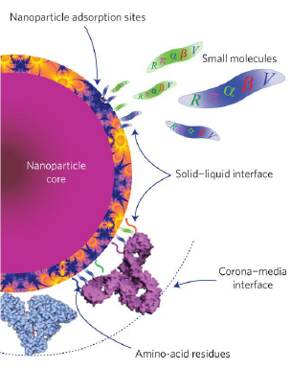
ECONANO
PROJECT
Call for competition
ACEE: Advanced Course
on Ecology Engineering
The European TEMPUS project ECONANO aims at the modernization of curricula on nanotechnology based Ecology Engineering (EE) in higher education system of Azerbaijan. The Advanced Course on Ecological Engineering-ACEE is organized in the framework of this project using a “Learning by doing” innovative training approach.
The course will be held in Baku at the Baku State University. The teachers will come from the BSU, AzUAC, QafQaz universities, AzECOLAB and from the EU partners of the project.
The training activity will last from September 2014 until mid June 2015 and will consist of three months of front end lectures and 3 months of training activities at a laboratory of one of the three EU university partners: Sapienza University of Rome , University Paris 13, University of Patras.
At the end of the training a thesis will be discussed in front of an International committee on June 2015.
The official language of the course is English.
Eligible candidates from Azerbaijan should be 6 years graduated in Ecology Engineering or equivalent degrees.
The total maximum number of students is 12 (4 from each AZ university partner of the project).
Selection of candidates will be based on Scientific Curriculum, age of graduation and an achieved certification in the English language.
During the first four weeks of September the students will be invited to attend an intensive course in the English language.
FINANCIAL SUPPORT: The EU project will pay the cost of the travelling and will assign 4.500 Euro to each student to cover the cost of subsistence for the three months abroad.
DEADLINES:
Application from June 16 until July 15, 2014.
Formal official enrolment by September 1, 2014.
Expected start of training: September 29, 2014.
End of training: June, 2015.
To obtain more information visit the web site of the TEMPUS project ECONANO
http://www.tempuseconano.eu/
or contact directly
Prof. Maxammadali Ramazanov, e-mail mamed_r50@mail.ru

